Slide 1
g
g
g
e1
e2
e3
c
c
c

Slide 2
Accelerating Distributed MoE Training and Inference with Lina
atc23

Slide 3
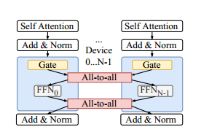
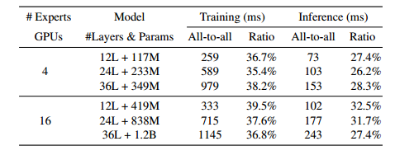
问题：
分布式MoE训练和推理是低效的，主要是由于模型计算过程中all-to-all的通信。

Slide 4
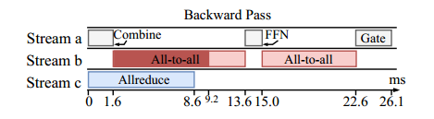
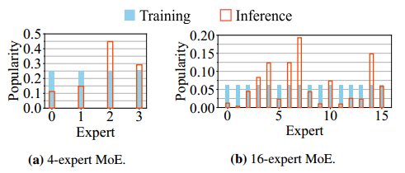
原因：
training
all-to-all和all-reduce在后向中重叠时经常会争夺网络带宽，导致计算阻塞时间延长
inference
负载不均衡不仅会延迟all-to-all的启动，而且还会导致设备之间传输大小和带宽利用率的不平衡

Slide 5
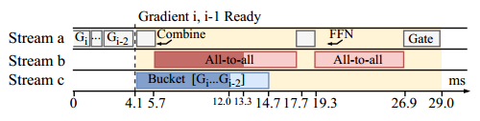
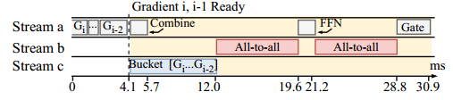
Prioritizing All-to-All Training
all-reduce不会阻塞计算，all-to-all阻塞计算
在后向中优先考虑all-to-all，避免all-reduce和all-to-all并发
Challenge：抢占all-reduce在当前的多gpu通信库是不可能做到的

Slide 6
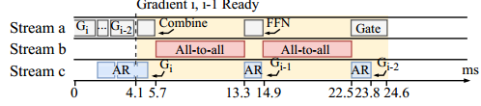
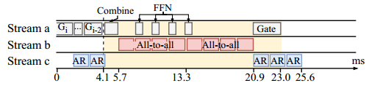
Tensor Partitioning and Micro-Ops
partitions the communication operations into small micro-ops and schedule them strategically in order to prioritize all-to-all without impeding all-reduce and the computation process
切分all-reduce
切分all-to-all和FFN，all-to-all和FFN并行

Slide 7
Scheduling Resources in Inference
动态调度每个专家的资源，以平衡每个设备的工作负载;
受欢迎的专家分配更多的设备
Challenge: know the expert popularity distribution, before the input is processed by the gating network
similar tokens naturally tend to be processed by the same or similar experts in each layer

Slide 8

Estimating expert popularity in i+1 layer
In the profiling stage, collect the expert selection results of all tokens
group tokens that select the same experts from layer i−l to layer i, which represent a unique sample path of experts used.
同一组的 token 相似
For each sample path j, compute the expert popularity distribution for layer i+1.
同一组 token 选择 i+1 层的专家的可能性均值？
estimate the next layer’s expert selection distribution for each sample path
In each layer i, for a sample path j, pick the top-k expert(s) of the i+1 layer from and use their probabilities to represent expert popularity

Slide 9

Two-phase scheduling
Phase one
在更多的设备上复制受欢迎的专家，并将不受欢迎的专家打包到更少的设备上。
专家e的设备总数由以下公式确定
将专家放在空设备上
experts are not amongst the top-k list of any tokens：如果有剩余的空闲设备，它们将被平均分配;否则被随机分配到一个设备。

Slide 10
Phase two
在门控网络选择实际专家后，对基于估计的调度决策进行微调。
通过比较总体前2k名专家来检查选择结果是否明显偏离估计。
如果两个列表相同，则不需要进行微调，并继续进行推理。否则，调度器将按照阶段1中相同的逻辑，使用现在可用的实际专家流行度重新计算资源分配。

Slide 11
